Slide 1


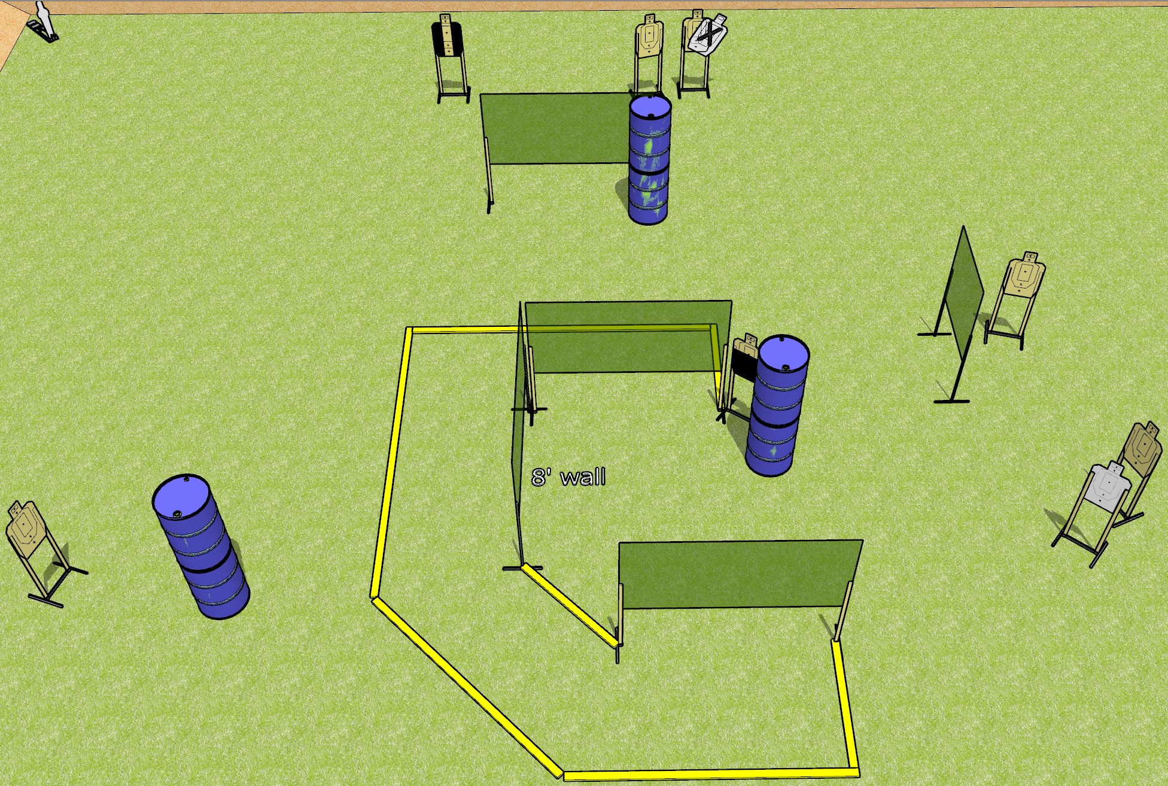
 | Dothan Gun Club – USPSA Match Hook Course Designer : Drew Coleman
Round Count 15 rounds 7 USPSA 1 mini popper
Equipment List 9 wall feet 3 medium fault lines 1 tuxedo, 1 50%

Slide 2
Hook
Written Stage Briefing
Hook is a 15 round, 75 point, Comstock course of fire. There are 7 USPSA targets and 1 mini popper. The best 2 hits on paper will score, and steel must fall to score. The start signal is audible.
Handgun start position is heels touching the downrange fault line facing uprange, wrists above shoulders. Handgun is loaded and holstered.
PCC start position is toes touching the downrange fault line, stock on belt. Loaded carbine is held with both hands, safety on.
On start signal, engage targets as they become available from within the shooting area.

